Slide 1

DAYANANDA SAGAR COLLEGE OF ENGINEERING Shavige Malleshwara Hills, Kumaraswamy Layout, Bangalore-560078 (An Autonomous Institute affiliated to VTU, Approved by AICTE &ISO 9001: 2008 Certified) Accredited by National Assessment & Accreditation Council (NAAC) with ‘A’ Grade Department of Mechanical Engineering
Batch Number 22
Major Project Phase-1 Presentation
Title: Design and development of Hybrid Two-wheeler
Guide Name | Dr. P Sudhakar
Designation | Asst. Professor
Student Name | 1. Mohammed Saqhib | 2. Milan Sonnad | 3. Mohammed Hussain Khan | 4. Himanshu Jha
USN | 1DS21ME437 | 1DS21ME435 | 1DS21ME436 | 1DS20ME032

Slide 2
Abstract
The transition towards more sustainable and eco-friendly transportation solutions has become an urgent global imperative. In this context, the conversion of conventional internal combustion engine (ICE) vehicles into Hybrid Electric Vehicles (HEVs) stands as a crucial step towards reducing greenhouse gas emissions, enhancing fuel efficiency, and mitigating environmental impacts. This abstract provides a concise overview of HEV conversion, highlighting its key principles, benefits, and challenges.
The increasing urbanization and environmental concerns have propelled the need for sustainable transportation alternatives. Hybrid two-wheelers have emerged as a promising solution to address these challenges by combining the advantages of both internal combustion engines (ICE) and electric powertrains. This abstract provides an overview of the concept, benefits, and potential impact of hybrid two-wheelers on urban mobility.

Slide 3
Introduction
Hybrid two-wheelers are vehicles that combine two distinct propulsion systems: an internal combustion engine and an electric motor powered by a rechargeable battery pack. This integration allows riders to switch between these two power sources, optimizing efficiency and performance according to their specific needs and conditions. Hybrid two-wheelers may vary in design, but the core principle remains the same controlling the strengths of both combustion and electric technologies.
Parallel hybrid: In a parallel hybrid vehicle, an electric motor and an internal combustion engine are coupled such that they can power the vehicle either individually or together. Most commonly the internal combustion engine, the electric motor and gearbox are coupled by automatically controlled clutches. For electric driving, the clutch between the internal combustion engine is open while the clutch to the gearbox is engaged. While in combustion mode the engine and motor run at the same speed.

Slide 4
Literature survey
Study on the implementation of Hybrid Two wheelers in the Indian Market by Telidevara Venkat Sai Dhruv, Kardile Ajay Sadashiv gives the brief about the market values for current hybrid vehicles compared to petrol and diesel vehicles and electric vehicles. This paper helps to understand the market capital.
Development of Hybrid Two-Wheeler Vehicle (Scaled Model) by Rushi S. Shenghani, Nayan J. Patel, Chirag K. Jain, Himanshu Rawat, B. R. Chaudhari states the different types of technical challenges arised in manufacturing of hybrid propulsion and shows the design of hybrid vehicle.
Design and Fabrication of Hybrid Two-Wheeler by Inzamam Ul Haq Rizvi Manav Matliwala Smit Shah Pappu Yadav and Mr. Jignesh Soni shows the advantages of connecting both IC engine and motor are directly to the drive system so that they can individually or jointly based on power requirement.
Design And Fabrication Of Hybrid Two Wheeler by N. Boopalan, Marlon Jones Louis, A. K. Nachimuthu shows the one basic design for the hybrid electric bike and basic calculations for selecting the components.
Design and Deployment of Hybrid Electric Vehicle by Harpreet Singh Matharu, Vaibhav Girase, Dr. D. B. Pardeshi, P. William gives the information about the architecture of parallel HEV and shows the method for integrating the systems.

Slide 5
Objectives of the project
Improved Fuel Efficiency: One of the central goals of hybridization is to enhance the vehicle's overall fuel efficiency. By combining an ICE with an electric motor and battery, the hybrid two-wheeler can optimize power usage, reducing fuel consumption and increasing the distance it can travel on a single tank of fuel.
Reduced Emissions: The integration of an electric motor enables the two-wheeler to operate in electric-only mode, significantly reducing tailpipe emissions. This reduction in greenhouse gas emissions contributes to improved air quality and helps combat climate change.
Enhanced Performance: Some hybrid two-wheelers aim to improve overall performance, including acceleration, top speed, and handling, while maintaining fuel efficiency. This objective can attract enthusiasts looking for both power and efficiency.
Extended Range: Increasing the range of a hybrid two-wheeler, either through more efficient fuel consumption or a larger electric battery, can be a key objective. This is especially important for users who require longer commutes
Market Differentiation: To compete in the market, an objective may be to create a unique selling proposition (USP) that sets the hybrid two-wheeler apart from competitors. This could be a distinctive design, innovative technology, or a specific target market segment.
Sustainability: Incorporating sustainable and eco-friendly materials and manufacturing processes can be an objective aligned with environmental responsibility.

Slide 6
Method and Methodology
Define Objectives and Requirements: Specify the requirements for your design, including power output, range, weight, and safety standards. And aiming for better fuel efficiency, reduced emissions, increased performance.
Market Research: To understand consumer preferences and trends in the two-wheeler industry. And Identify potential competitors and analyze their hybrid two-wheeler offerings.
Vehicle Selection: Choose a suitable two-wheeler model for the conversion based on factors like size, weight, and compatibility with hybrid components.
Conceptual Design: create initial concepts for hybrid two-wheeler and Considering the integration of an internal combustion engine and an electric motor and sketches and preliminary design ideas.
Detailed Design: create detailed engineering drawings and specifications for all components of the two-wheeler, including the frame, engine, motor, battery, and transmission and Selecting appropriate materials and manufacturing processes.
Component selection: Source the necessary components, such as the internal combustion engine, electric motor, lithium-ion batteries, and other electronic components.
Integration and Prototyping: Build a prototype of the hybrid two-wheeler by integrating all the components and Test the prototype for performance, safety, and efficiency.
Certification and Compliance: Obtain the necessary certifications and approvals from regulatory authorities for the hybrid vehicle.

Slide 7
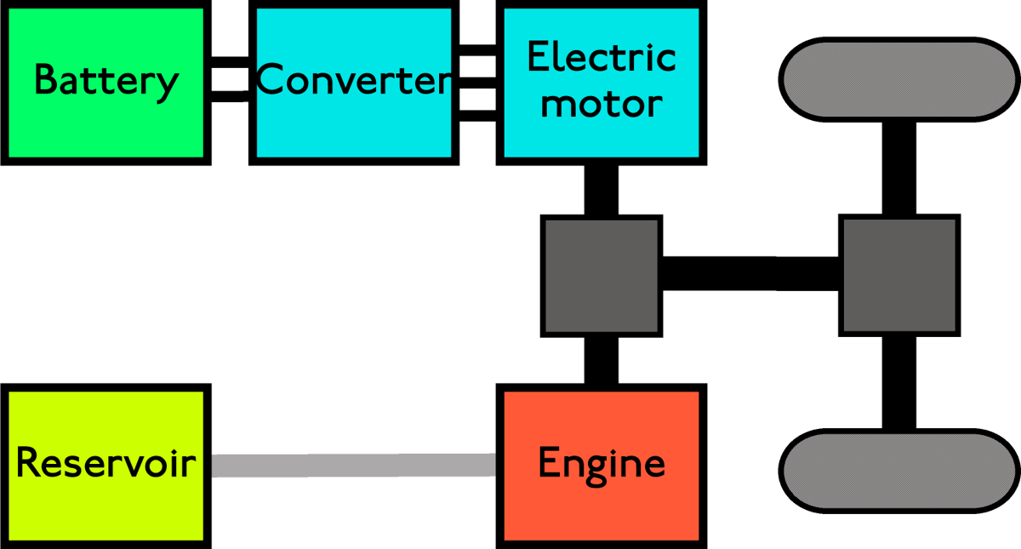
Parallel hybrid:

Slide 8
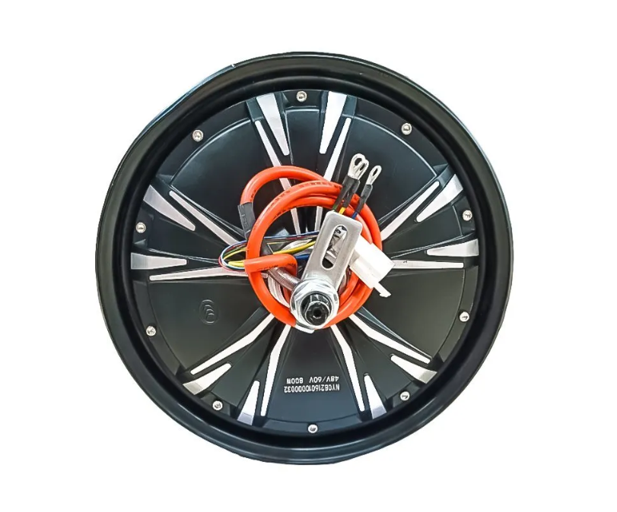
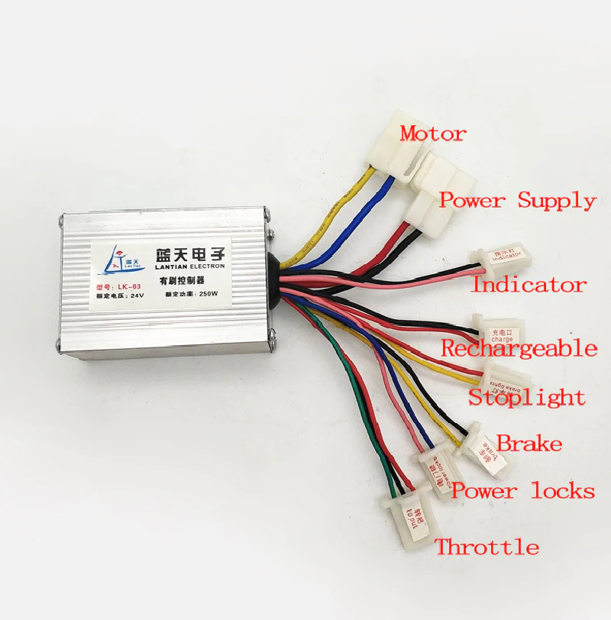
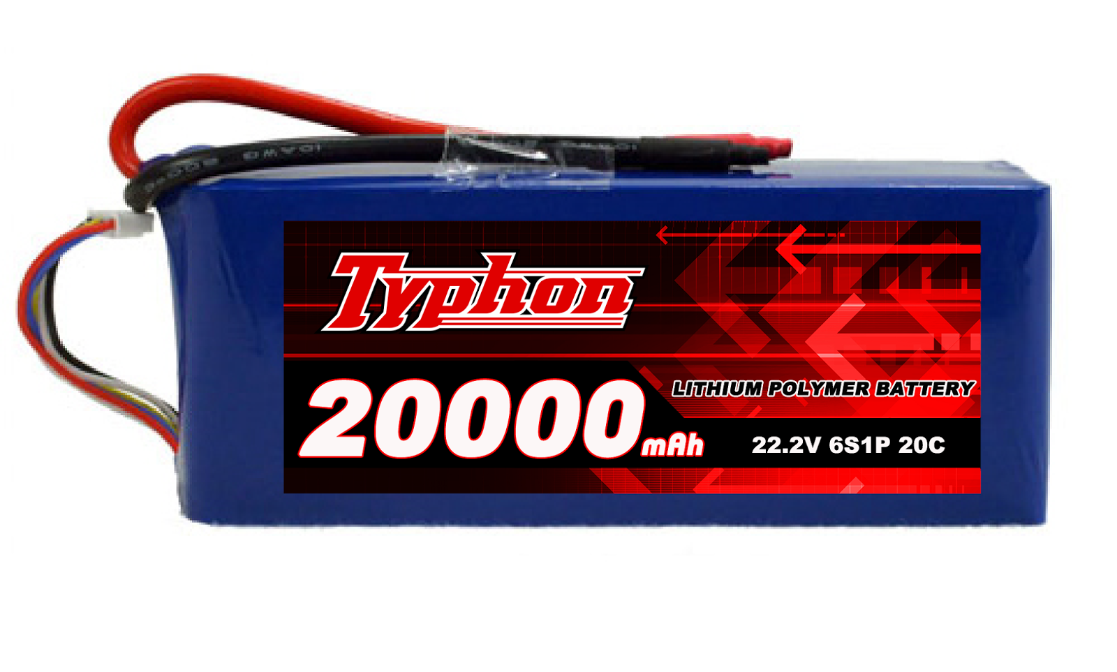
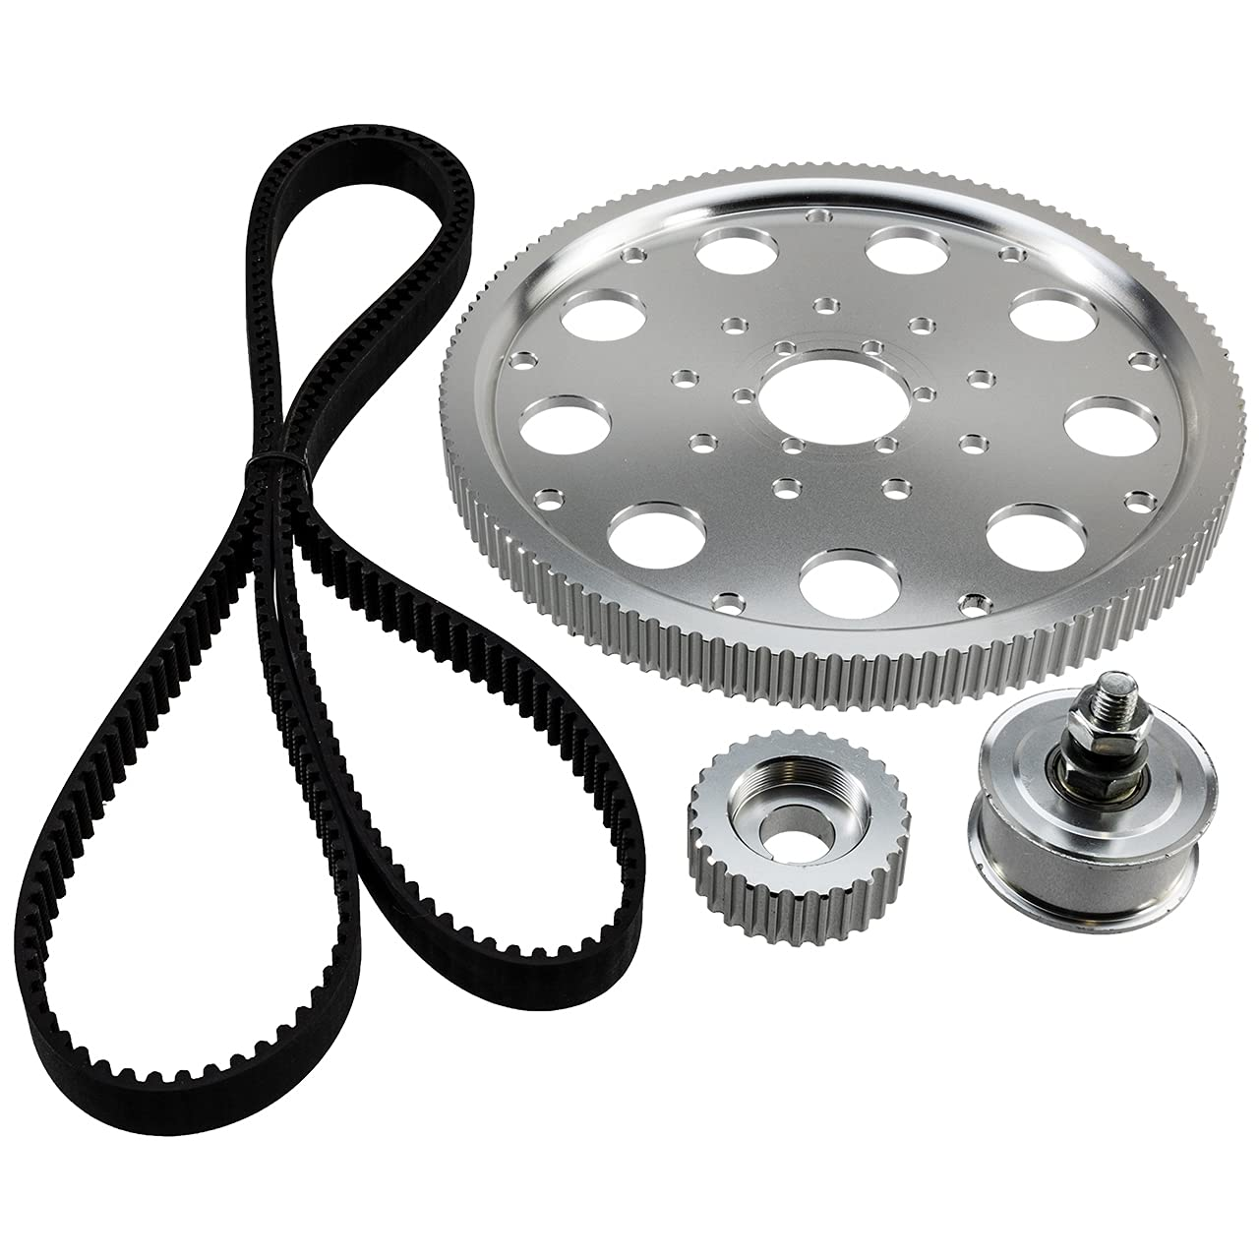
Selected components
BLDC Hub motor
E bike controller
Battery (22.2V-20000mah)
Belt drive

Slide 9
Budget details:
Particular | Estimated cost
HUB MOTOR (48V-800WATT) | 6000-8000
E BIKE CONTROLLER | 2500
BATTERY (22.2V-20000mah) | 8000-10000
FABRICATION COST | 5000
TVS ES | NILL
DRIVE BELT AND ITS ASSEMBLY | 3000
TOTAL | 28500

Slide 10
References
https://www.google.com/search?sca_esv=569467049&rlz=1C1YTUH_enIN1027IN1027&hl=en&sxsrf=AM9HkKn0tgk2_KN8DwZKHmTjldLyaKvHeg:1695996892708&q=electric+motorcycle+belt+drive&tbm=isch&source=lnms&sa=X&ved=2ahUKEwj8xtHigNCBAxUIz2EKHeamDhoQ0pQJegQIDBAB&biw=1536&bih=747&dpr=1.25#imgrc=BNRoxBrmKlVdoM
https://robokits.co.in/e-bike/motor-with-driver
https://www.indiamart.com/proddetail/48v-electric-bike-battery-19833332930.html
https://www.google.com/search?sca_esv=569467049&rlz=1C1YTUH_enIN1027IN1027&hl=en&sxsrf=AM9HkKn0tgk2_KN8DwZKHmTjldLyaKvHeg:1695996892708&q=electric+motorcycle+belt+drive&tbm=isch&source=lnms&sa=X&ved=2ahUKEwj8xtHigNCBAxUIz2EKHeamDhoQ0pQJegQIDBAB&biw=1536&bih=747&dpr=1.25#imgrc=BNRoxBrmKlVdoM

